Slide 1



Overview of Pivotal Data Science Offering for ATB Financial
Chris Rawles, Sr. Data Scientist
February XX, 2017

Slide 2
Agenda
Introduction to Pivotal Data Science
Our Team
Data Science Tools of the Trade
Case Studies / Past Value Delivered
Malicious Intent Identification for Credit Card Accounts
Text Analytics – 401K Asset Churn Prevention
Network Security – Lateral Movement Detection
Data Science on Pivotal Cloud Foundry – Model Operationalization
Let’s Get Started

Slide 3
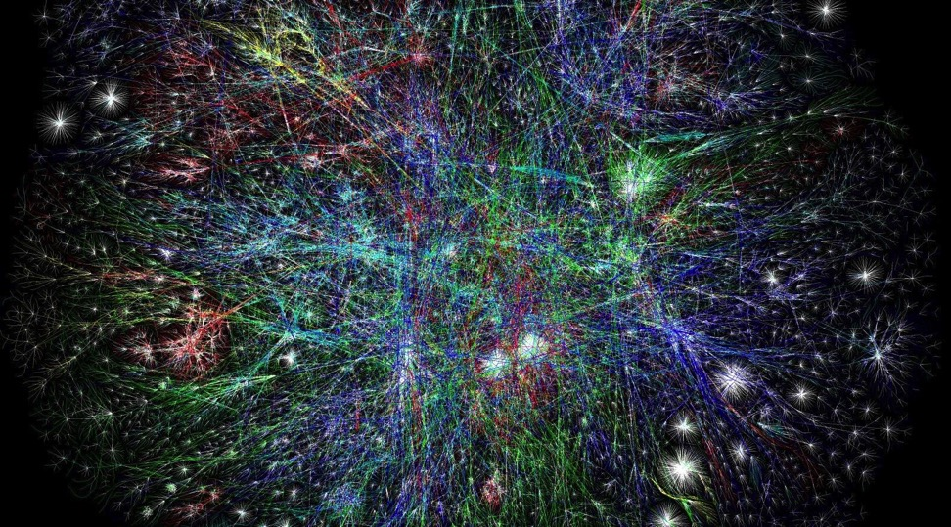
Great companies leverage Big Data to fundamentally change the consumer experience and pioneer entirely new business models.
Notes:
At Pivotal, our mission is to transform the way the world builds software. Central to that mission is being great at working with data. Whether managing data, analyzing it or connecting insights with applications, we help our clients choose the right architecture plus the right algorithms to power their digital transformation.
How does the data business fit in with Pivotal’s overall mission? Think of great software and not just transforming how the world writes and deploys code but builds software and software experiences. Data is a really important part of that and that’s what creates these new experiences and new business models. You are really able to tap into and take advantage of that at a totally different scale.

Slide 4
Pivotal Data Science Team & Agile Data Science

Slide 5

Pivotal Data Science Team
Established in 2010.
25 data scientists with diverse backgrounds.
Worked with many companies from finance, automotive, utilities, healthcare, insurance, telco, and retail industries.
Now integral part of Pivotal Data Engineering.
With our customers we have been defining what agile means for data science.

Slide 6







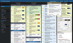
Agile Data Science @ Pivotal Labs
User Centric Data Science
Pair Programming
Test Driven Development
Standups
Retros
Continuous Integration
Tracker

Slide 7
Tools of the Trade

Slide 8
“Big Data”
Operational Data
Commercial & public data
Dark data
Social media

Slide 9












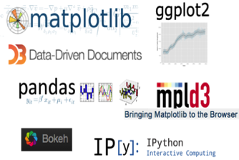











Pivotal Data Science Toolkit
Platform
P L A T F O R M
Spring Cloud Data Flow
KEY TOOLS
KEY LANGUAGES
PL/X
Modeling Tools
Visualization Tools

Slide 10


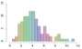
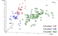

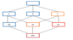
Functions
Predictive Analytics Library
Supervised Learning
Regression Models
Cox Proportional Hazards Regression
Elastic Net Regularization
Generalized Linear Models
Linear Regression
Logistic Regression
Marginal Effects
Multinomial Regression
Ordinal Regression
Robust Variance, Clustered Variance
Support Vector Machines
Tree Methods
Decision Tree
Random Forest
Other Methods
Conditional Random Field
Naïve Bayes
Unsupervised Learning
Association Rules (Apriori)
Clustering (K-means)
Topic Modeling (LDA)
Data Types and Transformations
Array Operations
Dimensionality Reduction (PCA)
Encoding Categorical Variables
Matrix Operations
Matrix Factorization (SVD, Low Rank)
Norms and Distance Functions
Sparse Vectors
Time Series
ARIMA
Model Evaluation
Cross Validation
Statistics
Descriptive
Cardinality Estimators
Correlation
Summary
Inferential
Hypothesis Tests
Other Statistics
Probability Functions
Other Modules
Conjugate Gradient
Linear Solvers
PMML Export
Random Sampling
Term Frequency for Text
Aug 2015
Notes:
List of MADlib functions is growing every day.

Slide 11

Data Parallelism through PL/X
For embarrassingly parallel tasks, we can use procedural languages to easily parallelize any stand-alone library in Java, Python, R, pgSQL or C/C++
The interpreter/VM of the language ‘X’ is installed on each node of the MPP environment
SQL
Master
Host
Standby
Master
Interconnect
Segment Host
Segment
Segment
Segment Host
Segment
Segment
Segment Host
Segment
Segment
Segment Host
Segment
Segment
User Defined Functions
…
CREATE FUNCTION pymax (
a integer,
b integer)
RETURNS integer
AS $$
if a > b:
return a
return b
$$ LANGUAGE plpythonu;
SQL wrapper
Source language code
Source language declaration

Slide 12









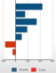
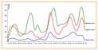
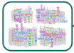
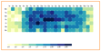


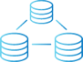


Pipeline of a Pivotal Data Driven App
Data Feeds
Apps
Continuous Model Improvement
Ingest
Filter
Enrich
Route
Model Building
Model Tuning
PL/X
Data Fabric Ecosystem
Business Levers
Greenplum
MLlib

Slide 13

Use Cases
Malicious Intent Identification for Credit Card Accounts
Text Analytics – 401K Asset Churn Prevention
Network Security – Lateral Movement Detection
Data Science on Pivotal Cloud Foundry – Model Operationalization

Slide 14
Malicious Intent Identification for Credit Card Accounts
Financial Services Company

Slide 15





Malicious Intent Identification
Customer
A consumer financial services company
Business Problem
Identify malicious intent on current portfolio and provide Red, Yellow, and Green accounts utilizing determined malicious intent likelihood
Challenges
Integrating multiple data sources (application, transactions, weblog, and call center) consisting of 1700 variables and 10+ billion rows
Class imbalance problem—“needle in the haystack” as malicious accounts constitute less than 0.1% of all accounts
Low false positive rate is a business need
Solution
Built 3 different models for identifying malicious intent at the application level using a supervised learning approach
Improved current capabilities resulting in a 9x improvement in model accuracy and lowering false positive account
Worked hand-in-hand with domain experts for duration of project
Built a decision tree model for quick wins to augment existing capabilities identifying fraudulent accounts with a low false positive rate which resulted in $4MM annual savings

Slide 16
Data Sources
Account level data
Application level data
Credit Bureau application information
Four separate application level tables
Transactional data
Purchases using credit cards
Weblog data
Customer web page clickstream data
Call center data including interactive voice response (IVR)

Slide 17
Business Goals
Identify and shut down malicious intent accounts before they bust-out resulting in lost money
Reduce false positive rate – i.e. not shutting down non-malicious accounts
Gain a deeper understanding of key indicators of malicious intent
Develop Red, Yellow, and Green classification system to identify high-risk accounts

Slide 18
Approaches
Data scientists worked hand-in-hand with domain experts to build effective features and an accurate model
Built 3 different application-level machine learning models to predict likelihood of malicious intent training on historical data and validating on new data
Built a decision tree model providing quick wins to augment existing capabilities identifying fraudulent accounts
Built a behavioral-level model to capture account behavior over time to identify key behaviors of fraudulent activity
Verified results with domain experts using 260 new accounts

Slide 19
Results
Utilized model scores and classify accounts into three groups—green, yellow, and red
Green group consists of low-risk accounts
Red group consists of high-risk accounts
Improved current modeling capabilities resulting in a 9x improvement in accuracy and a lower false positive rate
Also built a decision tree model to provide quick wins identifying malicious clusters (including a cluster with 40% malicious accounts)
These quick wins resulted in an annual savings of $4MM

Slide 20
Text Analytics – 401K Asset Churn Prevention
Financial Services Company

Slide 21

Data Science: 401(k) asset churn prevention
Business Problem: Identify predictive drivers that minimize churn of 401(k) participants to competitors.
Motivation: Predict and prevent churn events to reduce outflow of assets. Rank participants on potential assets lost and probability of churn.
Determine and characterize causes of churn:
Product or service deficiency
Attrition from product or service due to quality, satisfaction, or expectations
Loss of competitive advantage
Monetary (e.g., substitute is less expensive)
Offering (e.g., substitute has more features, more accessible)
Customer change
Unable to participate in business (loss of job)
Client
Client’s competitors

Slide 22
What did we use?
Hardware | Software | Data | Methods
Full rack Data Computing Appliance (DCA) 288 cores, 110 TB compressed capacity | Platform Greenplum Database (GPDB) Languages PL/pgsql PL/Python Java R Madlib Collaboration Chorus Spotfire SharePoint | Structured data Accounts Transaction data Plan and investment performance Basic macro-economic time-series Unstructured data Call log data (2M records) Weblog and session data (1TB) | Decision trees SVM Stepwise regression VIF Logistic regression K-means clustering Cox proportional hazard model Clickstream analysis

Slide 23
Predict and explain participant churn behavior
Derived definitions for different types of churn (e.g., plan sponsor churn, internal vs. external churn, churn to competitors)
Developed complex predictive and explanatory models to identify predictive drivers that minimize churn of 401(k) participants
Unprecedented integration of data originating from multiple warehouses across business units and external data providers.
Integrated structured and unstructured data (e.g., mapping weblogs to transactions)
Model-based ranking of participants on potential assets lost and probability of churn.
Transaction data
Yahoo Finance and Dept. of Labor
Missing value imputation
Derive dependent variable
Clickstream analysis
Plan and fund data
800M
Ensemble
Model
Population for analysis
Model feature table
…
Support Vector Machines
Weblog data
Clean and filter data
Define population according to business needs
Convert data to time series
Cox prop. model
External data tables
Internal data tables
Modeling tables
Models

Slide 24
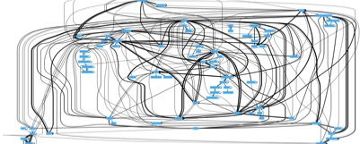
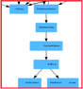
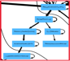
Clickstream analysis for website churn behavior
Clickstream analysis
Identified common click paths used by churning users (e.g., research on obtaining account closing documents, searches for rollovers)
Identified frequently requested resources
User session analysis
Clustered user sessions → compared clusters to known aggregator services
Identified previously unknown aggregators
Simplified user clickstream
Login
Logout
1
Home Screen
6
2
4
Research
3
5
Distribution
800M
Clickstream analysis
Model feature table
Ensemble
Model
…
Support Vector Machines
Notes:
Aggregator sessions cannot initiate churn -> they are just an indicator that a user is using an aggregator but are not indicative of any behavior. Hence they need to be excluded from the analysis.

Slide 25
Results and their impact
Ranked participants on potential assets lost and probability of churn
Model results are used by call centers to contact participants and offer customized products to prevent churn
Model results are used for incoming call routing based on risk of churn and assets at risk
Implemented marketing campaign A/B testing for outreach strategy
Identified additional aggregator services from clusters of user sessions on company website → network security team is using this information for access control
Clickstream analysis of frequently requested resources prompted website layout and site retrieval optimization
Proved the capabilities of Pivotal’s technology stack and methods to a wide audience within the company

Slide 26
Network Security: Lateral Movement Detection

Slide 27
Stages of an Attack
Threats handled by IDS, Firewalls, SIEM, etc…
How do we stop smart, patient intruders who have already made it past the perimeter?
Research:
Port scans
Ping weeps
Social Engineering
Infiltrate:
Malware
Right-to-left-override
Webmail vulnerabilities
The bad guys are already on your network!
Lateral Movement: Pass the hash Traverse the network
Escalate Privileges
“Slow and Low”
Exfiltrate:
Intellectual Property
Financial Information
Employee PII

Slide 28
Lateral Movement Detection
Assumption
Acknowledge cyber breaches will occur
Problem Statement
Identify intruders on the network once they are already inside
Goals
Reduce malware-dwell time, typical 243 days
Detect behavior that cannot be detected by signature-based approaches
Approach
Establish baseline behavior per user and user group
Intruders want to spread malware and/or steal something valuable. Their behaviors don’t look the same as a regular user
Highlight users that do not act like their peers or activity that does not look like prior behavior as potentially fraudulent
Create a feedback loop to take security team’s input into consideration to reduce false positives

Slide 29
Data Sources
Active Directory logs of 7 months in the enterprise
10,144,078,886
Total AD event log
#Events with relevant ID
#Events wrt critical servers
#machines
#user accounts
686,104,047
357,236
14,806
13,080

Slide 30

Approaches
Graph-theoretic approach
Explore the access patterns using graph mining
Per-user temporal modeling
How does the user behaves different from his past behavior
Cross-user lateral modeling
How does his current behavior differ from other users in his past behavioral neighborhood
a.com
Print
Server
b.com
Finance
Server
Bi server
c.com

Slide 31
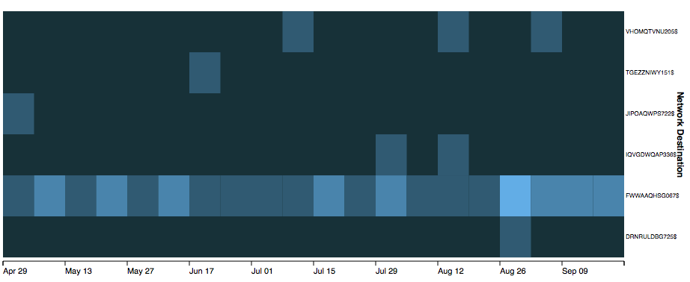
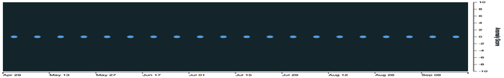
User-Server access pattern (Normal user)

Slide 32
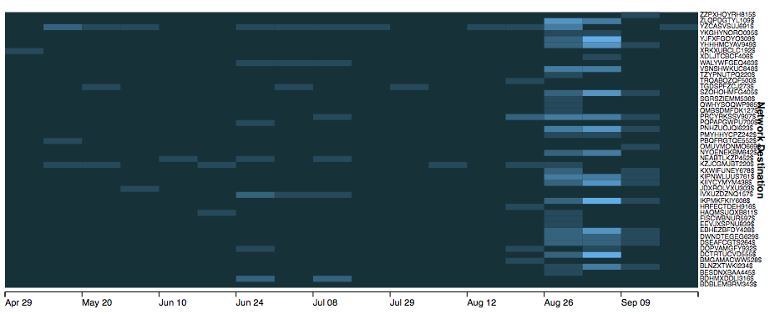
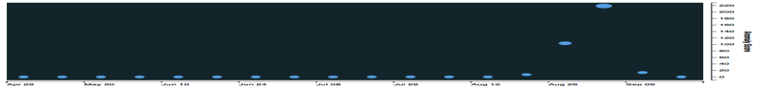
User-Server access pattern (Anomalous user)

Slide 33
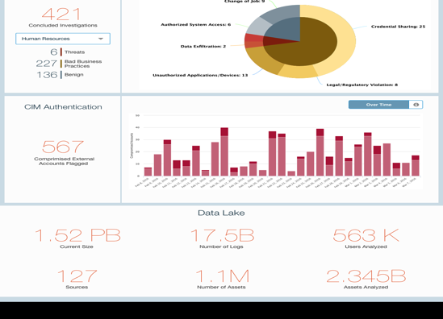
Lateral Movement Detection App

Slide 34
Key Takeaways
Pivotal & customer data science teams are aware of Sentry MBA
Models found a signal in the data in April
We see a big uptick in the use of Sentry MBA against our customer OVER 10 Million attempts in the First week of June
We identified the signature of most common Sentry MBA attacks
We are able to learn NEW signatures when the attacker makes adjustments Identified over 20,000 distinct accounts successfully compromised since April
Analysis can be run monthly, weekly, daily…
We plan to stay ahead of the curve and try to anticipate smarter attackers

Slide 35
Results
6 months of data for training. 7th month used for testing
Among 13K users, we detected anomalous cases:
3 out of 5 known data loss violators (in legal pursuit) users are detected with abnormal activities before the actual data theft events
Values in either detecting known anomalies earlier or undiscovered anomalies
The system is in operation today at the client environment.

Slide 36
Data Science on Pivotal Cloud Foundry:
Building, Deploying, and Scaling a Model to Twitter Scale (And Beyond)

Slide 37
Motivation
How do we bring a model into production?
Real-time and near real-time model application
Requires immediate prediction in response to events of interest
Examples: Uber/Lyft ride request, Google Search, Amazon product recommendation, self-driving cars, high speed algorithmic trading, etc.
Batch model application
For example, overnight batch application is sufficient for some data science tasks
Examples: Targeted marketing emails, LinkedIn summary email, daily cron jobs, etc.

Slide 38
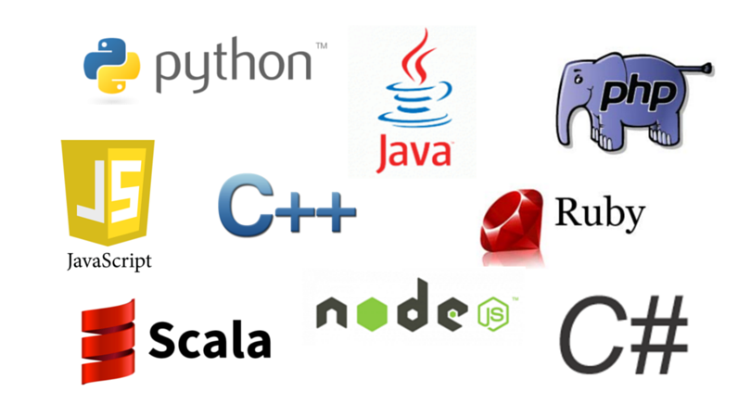
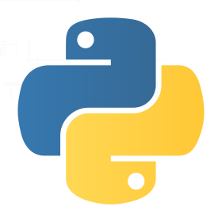

Bringing a model into production
What does the interface between data science and engineering look like?
Model persistence
Approaches
Re-write the code
Universal mark up model language (PMML and PFA)
Deploy the model in its native language
Production
Data science
Engineering

Slide 39
Deploying our modeling framework as a microservice using Pivotal Cloud Foundry
What does the interface between data science and engineering look like?
Production System E.g., data pipeline, end user, web app, etc.
REST
Notes:
CF determines app type (Java, Python, Ruby, …)
Installs necessary environment
Provisions and binds data services
Creates domain, routing, and load balancing
Continual app health checks and restarts

Slide 40
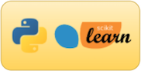

Application architecture
Apply the model
Model development
environment
Trained model
Live Tweets
Metrics
logger
Dashboard app

Slide 41
And many more use cases
https://blog.pivotal.io/data-science-pivotal

Slide 42
Alignment / Next Steps

Slide 43
Goals of Data Science Engagement
Teach our best practices through experience
Provide the customer with a quick win
Utilize underutilized/unexamined data and prove the predictive power of the data
Prove the value of running machine learning on the distributed computing platforms

Slide 44



Pivotal Data Science Engagements
ROADMAPPING
DATA JAM
DATA SCIENCE LAB
WHAT TO BUILD AND WHEN
Build your Data Science roadmap with hands-on workshops
Answer questions:
What to build and when?
Do we have the right data?
What is the value and effort for this model?
Build collaborative relationships
Increase data literacy
IDENTIFY TALENT
4-day hands-on Data Science training a fully-support DataJam
Enable employees to build models
Establish a DS culture via projects
Learn and apply new tools and DS paradigms
Identify untapped DS talent
BUILD A MODEL
Build a predictive model and extract meaningful data insights
Find value in existing datasets and identify new and underutilized dataset
Learn new tools and technologies for handling large datasets
Learn best practices

